Slide 1

Speak fluently
Intermediate

Slide 2
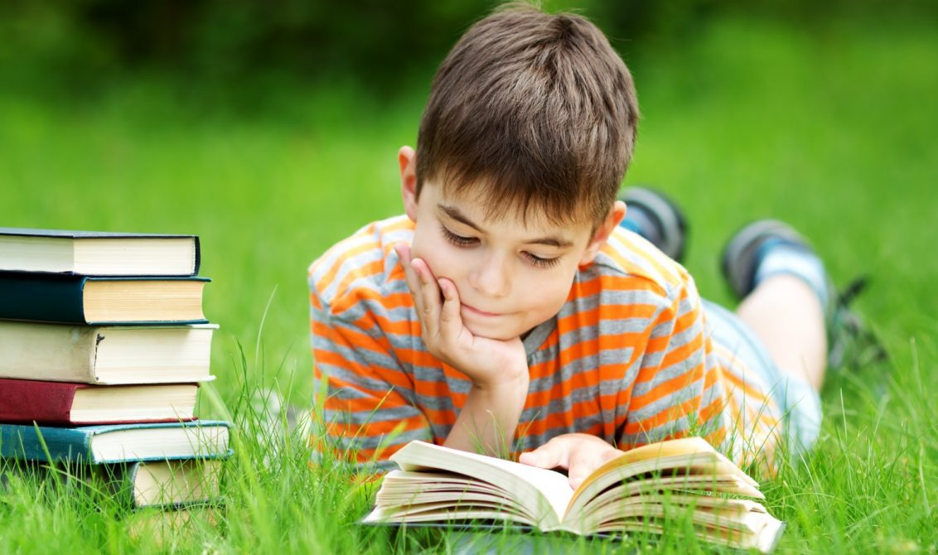
8. Reading

Slide 3
8. Reading
What is your favorite story?
Who is your favorite author?
Who is your favorite character?
What is your favorite genre?
Action
Mystery
Suspense
Detective
Science Fiction
Children's books
War
Non-fiction
Travel books
History
Biography
Autobiography
Classic Literature
Modern Literature

Slide 4
8. Reading
What is the longest book you have ever read?
How long did it take you to read it?
Have you ever belonged to a book club?
What books did you read?
What is the funniest book you have ever read? The saddest? The strangest?
Is there a time in your life when you read all the time?
How many hours do you spend reading in a week?
Do you have any ideas for a story for you to write?
Do you read books based on recommendations?
What are some of the books that were recommended to you?
What books have you recommended for other people?
Do you think that the internet and television will eventually make books obsolete?

Slide 5
8. Reading
How important is the cover of the book?
Do you watch a movie that came from a book?
Most people say books are often better than the movies that came from them. Is this true for you?
Did you enjoy reading books in school?
Is there a book that you have read more than once?
What was the title?
How many times did you read it?
Is there a book you just couldn't finish?
What was the title?
What is your favorite time of day for reading?
Where is your favorite place to read?
Do you listen to music while you read?
Do you often read book before go to bed?

Slide 6
8. Reading
What factors are important to you when choosing a book to read?
Reviews?
A Recommendation from a friend?
The front cover?
What was the last book that you read?
What is your favorite book of all time?
Have you ever read a book and then watched the movie? Which was better? Why?
Who is the most famous writer from your country?
Have you read any of their books?
Do you think that they are overrated?
What genre of book do you enjoy most?
Have you ever tried to read a book in English?
Do you think that it is more valuable to read a book than to watch television?
Have you ever lent books to your friends and never got them back?

Slide 7
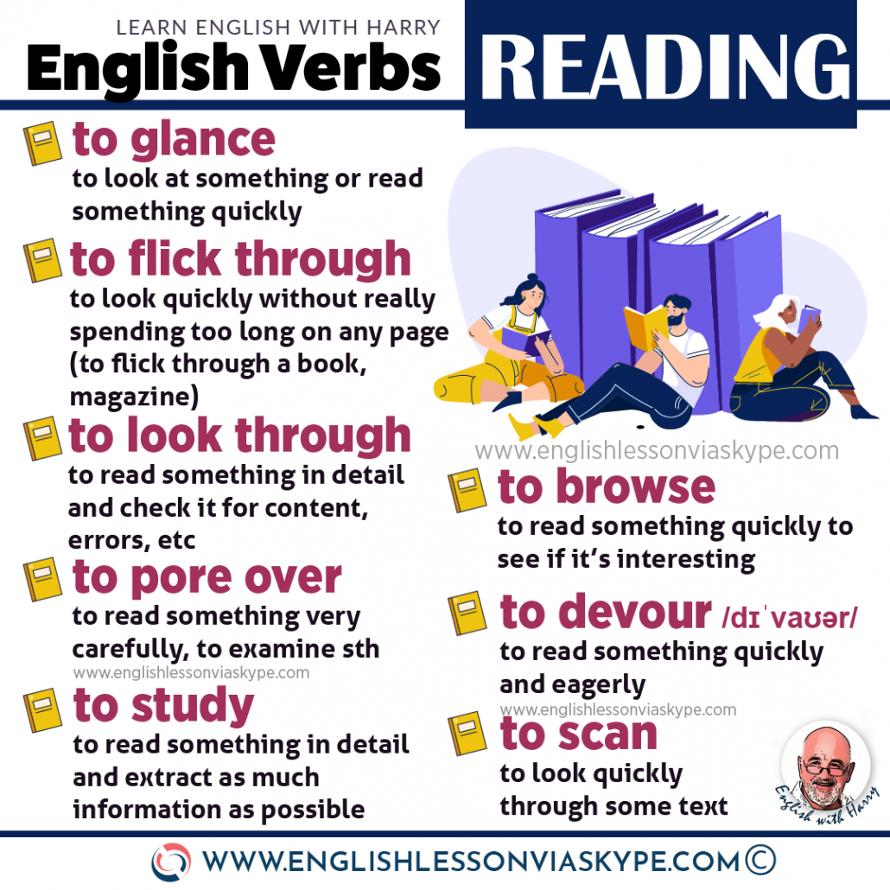
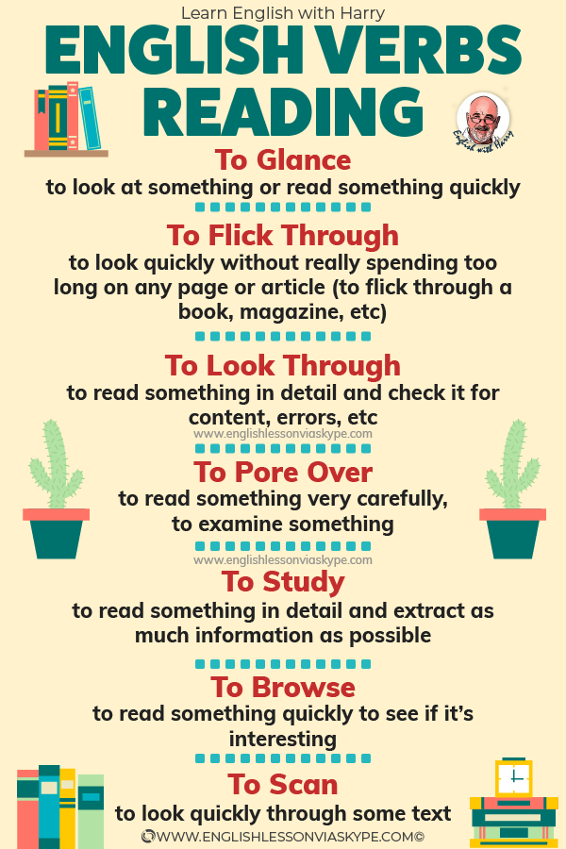
8. Reading

Slide 8
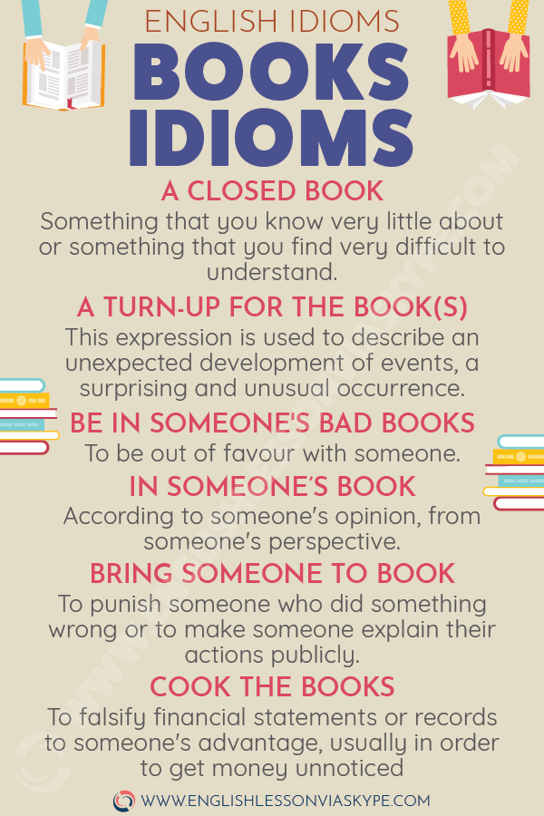
8. Reading

